Slide 1

Internship Studio Internship Project Submisison
Name : Aryan Tokas aryantokas8@gmail.com
+91 8800871609

Slide 2
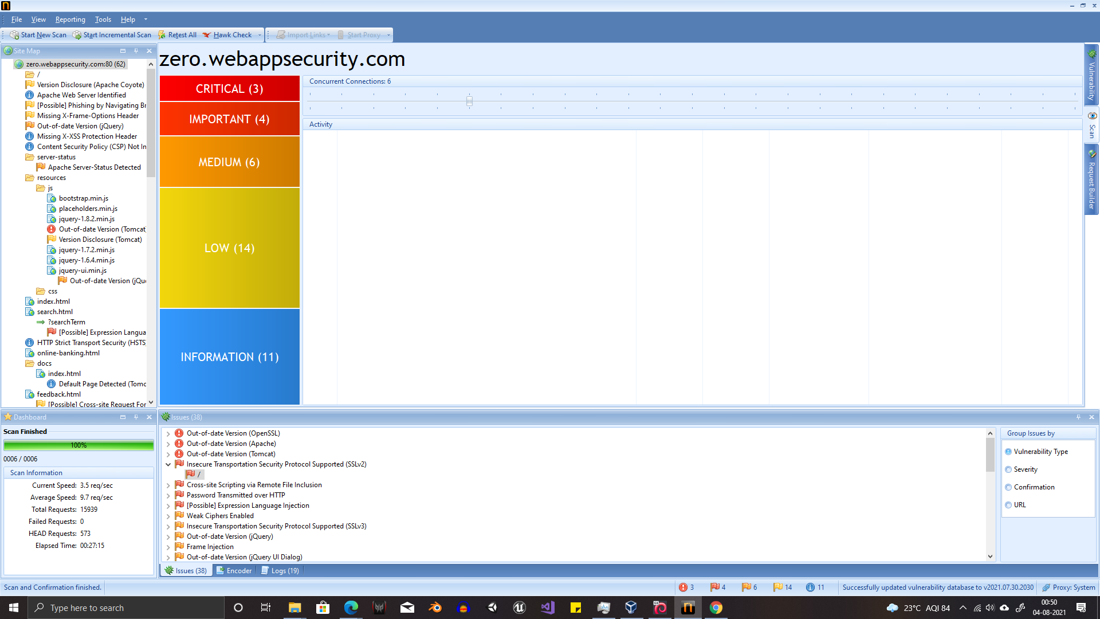

Slide 3
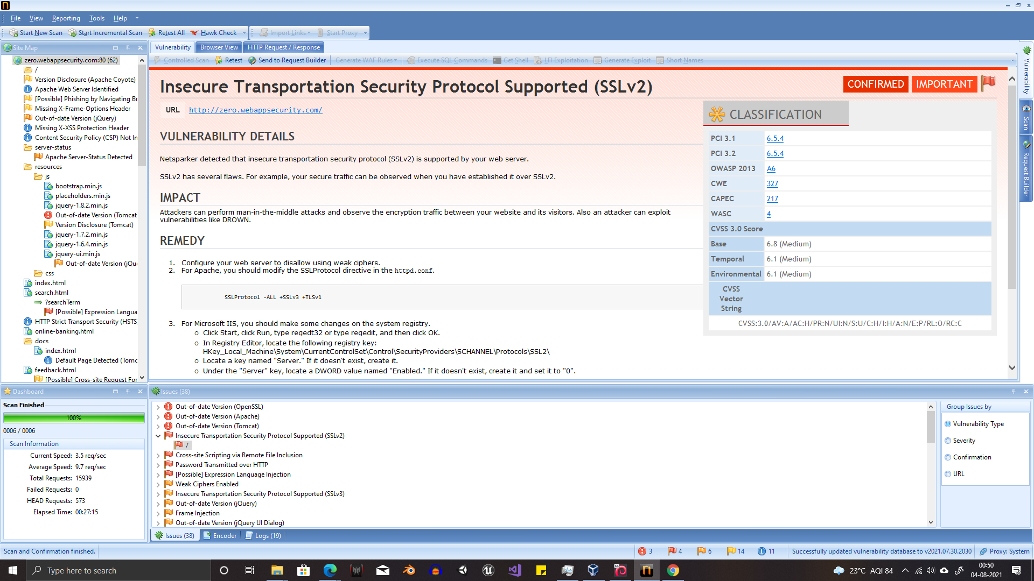

Slide 4
REPORT
Cross-Site Scripting Vulnerability Found
Site Name: Zero Bank’s Website
URL : http://zero.webappsecurity.com/
Details : In the given site, there was found to be a XSS remote file inclusion attack vulnerability. This would allow a person to make changes to the site using dynamic scripts, which is severe and can lead to the malicious party gaining the ability to make changes to the site, and even procure cookies and steal user data
Impact: An attacker may:
Steal session details
Change website’s appearance
Intercept data flowing from user to the server
Solution:
Arrival data filering: As soon as data arrives, only appropriate data must be accepted and malicious or spam data mus be filtered out
Data encoding If data is encoded at the time of output, it can be kept safe from attacks and helps in defending against XSS attacks ensuring that only authorized parties can access JS data

Slide 5
Thank You

